Slide 1
Gannon Knights
Problem 1
Paul K Benny¹ Peter Caulfield¹
1. Mechanical Engineering Department, Gannon University, Erie, Pennsylvania

Slide 2
CONTENTS
Our Understanding.
Approach
How it is implemented.
Results
Suggestions
Takeaways

Slide 3

Our Understanding of the Problem
Create a digital twin
Use to calculate damage to a machine from runtime sensor data
Will aid in maintenance

Slide 4

Approach
Linear SVM in Matlab
Literature review
Compare Matlab inbuilt models to find the best
Hurst exponents
Calculate cumulative values for previous portions of the independent variables’ datasets
Use as predictors in machine learning

Slide 5

How it is implemented?
Prepare and treat dataset
Train the model
Used the first week data
Testing and validation
Used the second week data

Slide 6
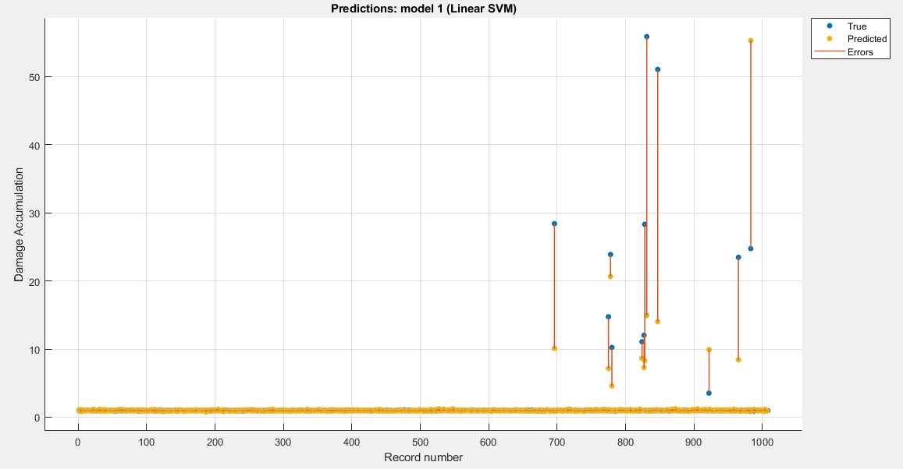

Results

Slide 7
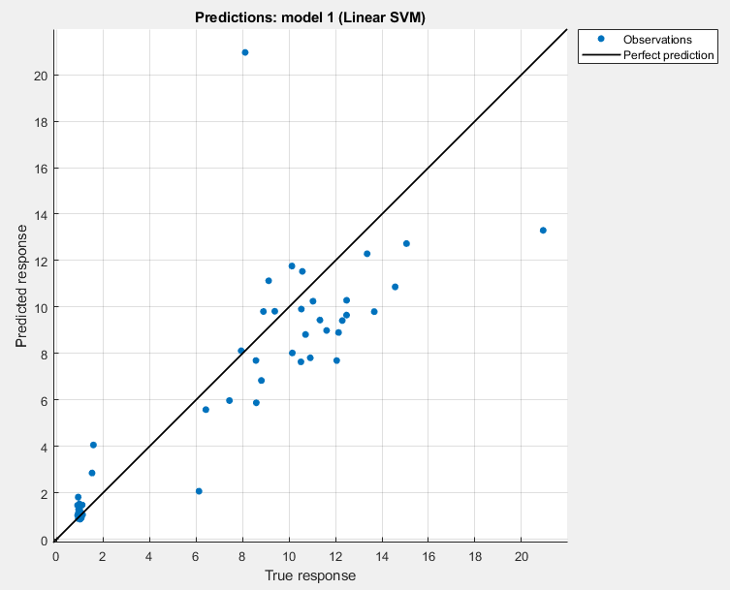

Slide 8
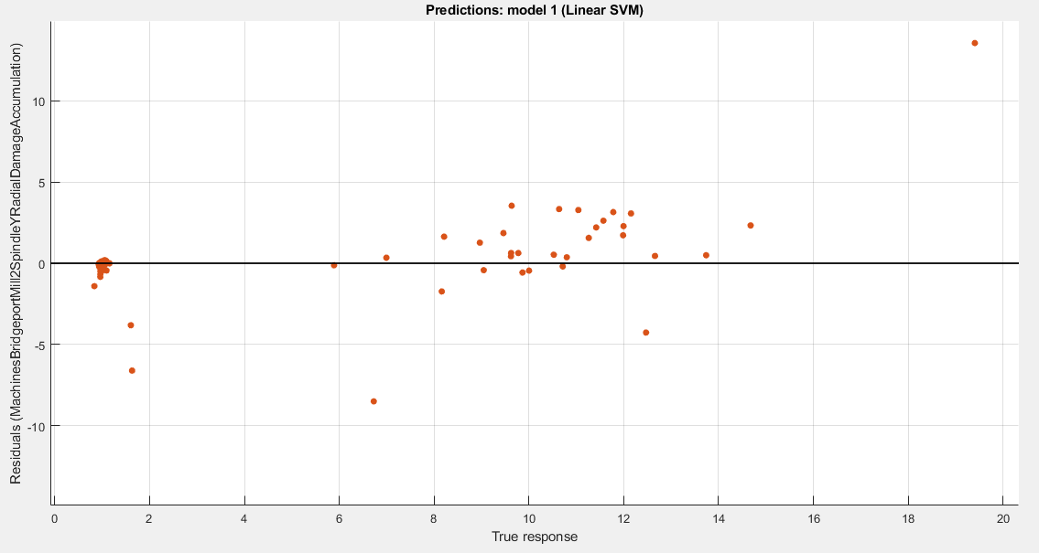

Slide 9
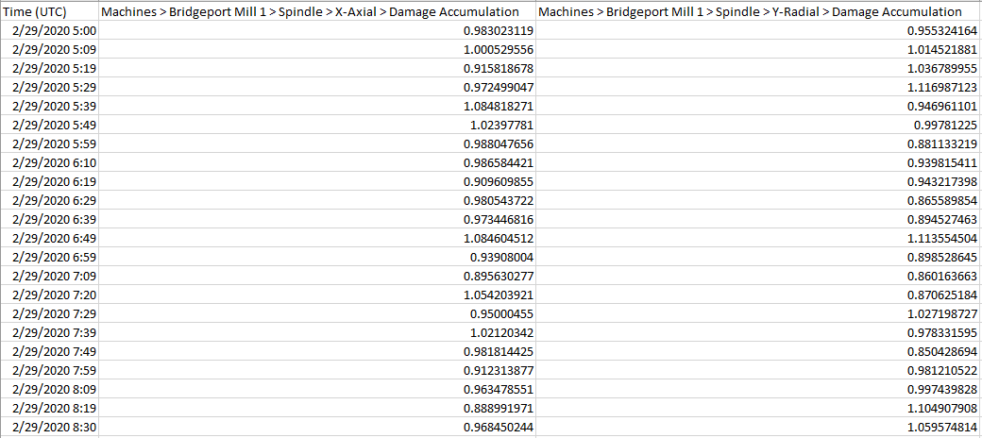

Slide 10

Takeaways
Linear SVM outperforms other ML models in this scenario.
Proof to the statement in the article published. https://doi.org/10.1002/emp2.12156
Multiple fields and bigger scope in predictive modelling.
Using SVM for a predictive model than for a classification model.
Inspiration for the freshmen.

Slide 11

Questions, Concerns & Suggestions…

Slide 12
Thank You

